Slide 1
COMM 204: LOGISTICS AND OPERATIONS MANAGEMENT
2022W EXAM REVIEW SESSION
Notes:
Introduce myself and explain what CMP is

Slide 2
COMM204
Today's session:
Pre-Midterm:
Process Analysis
Little’s Law
Variability
OM Triangle
Queuing Theory
Pk formula
Post-Midterm:
Demand Forecasting
Project Management
Inventory Management: Newsvendor, EOQ, RQ
Notes:
Remember to include breaks every 30 minutes
Run down of what the session willlook like
30% of questions will be pre midterm content, and 70% will be post midterm content

Slide 3
1
Process Analysis
Notes:
Explain what process analysis is and why we use it
Turning inputs into outputs.
Process definition

Slide 4
Process Analysis
Core Concepts: Flow Time, Capacity Rate, Bottlenecks
Flow time (Throughput time): lengths of time a unit spends in a cycle.
Capacity Rate: maximum rate at which units can flow through a process
Bottleneck: the “slowest” resource of the process- can determine the capacity rate of the process.
Starbucks Barista Crafting Beverage Process:
Flow time: how long it takes to make the drink.
Capacity rate: maximum rate at which drinks can be made (usually either in a minute or hour)
Bottleneck: which part of the beveraging crafting process slows the process down the most?
Notes:
Explain that these are the core concepts of process analysis, read slide

Slide 5
Process Analysis
Process Entities
Flow Units: The items that flow through the process
Activities: the transformation steps in the process
Resources: what performs the activity- have capacities
Buffers: storage units for flow units- may have finite size, ex: waiting room and queues
Decision points: “forks in the road”
Theoretical Flow Time: amount of time that a flow unit is in the process
Unit load: amount of time that a resource needs to process a flow unit
Notes:
Explain all of these, and add in the starbucks example and give starbucks related examples
-include shapes

Slide 6
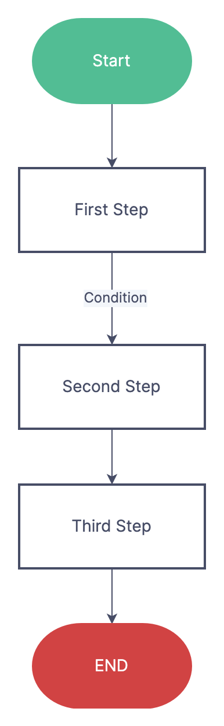
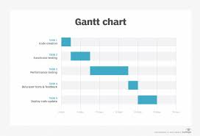
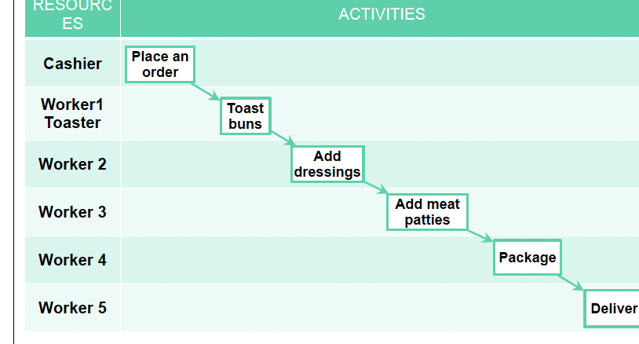
Analysis Presentation
Linear Flow Diagram
Swim Lane Flow Diagram
Gantt Chart
Note the shapes!
Square- Activities
Triangle- buffers
Diamond- decision points
Arrow- flow of materials
Notes:
“SO HOW ARE WE GOING TO SEE THIS INFORMATION”
-gantt chart: project management

Slide 7
Process troubles
Blocked process
First step: 60/ hour
Second step: 40/ hour
Starved process
First step: 40/hour
Second step: 60/hour
Notes:
There are two types of processes that can be classified as unbalance and cause processing delays.
Unbalanced processes
Blocked process- when next stage is busy
Starved process- when first stage is taking too long

Slide 8
How to increase capacity rate
Increase the size of the resource pool. (add a worker or machine)
Decrease the unit load ( with better technology)
*applying either of these to a resource that is not a bottleneck will not increase capacity rate
Notes:
Reminder of what resource pool
Can change theoretical flow time (will lower the total flow time) : remind what theoretical flow time is

Slide 9
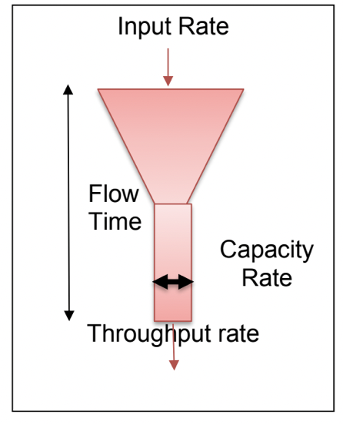
Visualizing Terms
Throughput Rate: actual output rate
Input Rate: Rate at which flow units arrive at the process
Flow time: average time for a unit to move through the system
Cycle Time: average time between completion of units
Notes:
When input rate > capacity rate, capacity rate = throughput rate
When input rate < capacity rate, throughput rate = input rate
When demand rate ( input rate) = capacity rate, you can be asked to calculate short run utlizations.

Slide 10
Utilization
Utilization how “used” a resource is
Throughput Rate / Capacity Rate AKA
Actual Output Rate / Maximum Output Rate
*Maximum 100%
What is utilization of worker who gets through 4 units per hour when they could get through 6 per hour?
Notes:
Relate this to the funnell analogy
-mention ideal utilization
How much the resource is actually being utilized

Slide 11
Implied Utilization
Captures the idea of overtime/ excess demand in the short run
Input Rate / Capacity Rate
Maximum CAN be over 100% in the short run
Ex: temp holiday employee labour
Notes:
How muc the resource is being used in response to customer demand
Go back three slides to make an example of this concept

Slide 12
Your turn!

Slide 13
Calculate the long term utilization!
 | Throughput Rate | Capacity Rate | utilization as a %
Cashier 1 | 2 | 3
Cashier 2 | 5 | 10
Cashier 3 | 2 | 2
Notes:
This will prove to be useful with our pk formula
In this example, the cashier are working against their own capacity rate.
But there may be questions when you are asked to calculate utilization in examples with the same capacity rate

Slide 14
Calculate the long term utilization!
 | Throughput Rate | Capacity Rate | utilization as a %
Cashier 1 | 2 | 3 | 66
Cashier 2 | 5 | 10 | 50
Cashier 3 | 2 | 2 | 100
Notes:
This will prove to be useful with our pk formula

Slide 15
2
Little’s Law
Notes:
Discrete average inventory, this helps with continuous average inventory
Establishes a relationship between average inventory, average throughput rate and average flow time

Slide 16
Little’s Law
I = R*T
I- Average Inventory
R- Average Throughput Rate
T- Average Flow Time
Be careful not to mix up R and T!
Notes:
T for time
R for Rate
This is something i always got confused!
AVERAGE AVERAGE AVERAGE
Simple calcuaiotkion but IMPORTANT concept, so dont forget it

Slide 17
Little’s Law summary
I = R*T
R = I/T
T = I/R
-correctly identify variables
-remember this is all “average”
-keep an eye out for units
Notes:
If you see average, consider that littles law could assist you through the question. They may not directly state to use the littles law, you may have to use intuitive thinking skills, and reealize this concept could help you
May see questions like lions gate where customers are segmented- more challenging question.

Slide 18
Practice Questions
At Lions Gate hospital, there are 20 births a day.
75% of deliveries require a 1 day stay. 25% of deliveries require a 3 day stay.
What is average occupancy of delivery floor?
On average, there are 25 people waiting for a given surgery.
On average, 1 surgery is performed per month
With the assumption that no patients die, how long do patients wait?
Notes:
Littles law practice question

Slide 19
Practice Answers
R = 20 births/day
T = 1*0.75 + 3*0.25 = 1.5 average flow time
I = 20 * 1.5 = 30 patients in the occupancy on average
I =25 patients waiting
R = 12 surgeries/ year
T = 25/12 = 2.08 years
Notes:
Littles law practice question

Slide 20


Notes:
Share during 1st break

Slide 21
3
Variability in Processes
Notes:
Variability is bad information in processes
-

Slide 22
Variability
Variable Inputs: ex: not knowing exactly when customers will show up to your store
Variable Capacity: not knowing what your capacity will be. Ex: farmers producing crops.
Notes:
Variability in processes occurs when the process has the potential to not go exactly as planned, and this arises from two variables: inputs and capacity.
Variability occurs from two things: variable inputs and variable capacity
Crop capacity can vary with weather conditions.
Inputs: better forecasting and better scheduling
Process: reduce process variability, better quality

Slide 23
Types of Variability
Predictable: knowable changes in an input and/or capacity rates
Ex: Advent Calendar sales will go up during christmas time.
Unpredictable: unknowable changes in input and/or capacity rates
Ex: how much will advent calendar sales increase during Christmas time?.

Slide 24
Variability
Controlling Variability
Predictable: making changes to the system.
Unpredictable: result of lack of information. Reduce by getting info!!
Notes:
Ask what types of changes we could make in reference to the examples on the last page?
What type of information in relation to the last slide?

Slide 25
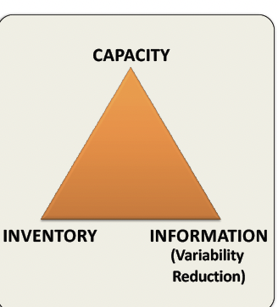
OM Triangle
Helps OM experts capitalize their strengths when facing random demand.
You cannot have low inventory, capacity and information. There is a trade off to pursuing capitalization of strengths.
Notes:
If asked the question “ what to do when you are not able to change capacity, or inventory, what do you do? Answers questions when you have two low spects of the triangle, how can you capitalize on your one strength?
Qualitative question

Slide 26
4
Queuing Theory
Pk-Formula
Notes:
Now that we know that variability occurs in processes,
Explain there are 6 different formulas to use, and they are all simple nough to remember, but it is knowing when to use them that is important.
Which formula to use will likely be inidtcated in the question, but there is a chance it wont be and you need to be prepared to know which formula to use for a given question.

Slide 27
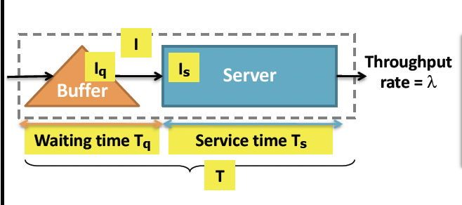
Queuing Theory
Iq: Average queue length
Is: Average number of customers being served
I: Average number of customers in the process = Is + Iq
Ts: Average time spent at server
Tq: Average time spent waiting in queue
Ts= Ts+Tq total average time spent in queue
Notes:
Things you can calculate with Pk formula

Slide 28
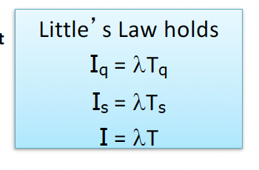
Little’s Law x Pk Formula
Little’s Law: Average Inventory = Avg Flow Time * Avg Throughput

Slide 29
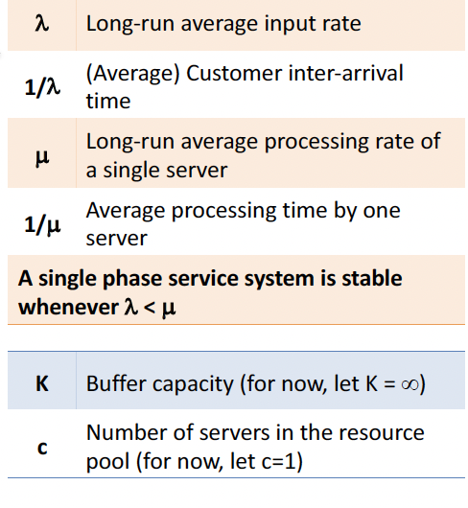
Queuing Theory
Notes:
Variables involved in pk formula

Slide 30
POLLACZEK-KHINCHIN (PK) FORMULA
Used to calculated average queue length (Iq). Ex: number of customers in line at Starbucks
Assumptions:
single queue
no limit on queue length
all units that arrive enter the queue
any unit that enters queue stays in system
FIFO
all units arrive independently of each other
Single server: we assume there is a single server unless other
Notes:
Assumptions for pk formula

Slide 31
SINGLE SERVER
Notes:
Single server will be indiciated in the question, so the next three formulas will be one of the ones to use when given a single server question. These questions are the same idea as multi=server, but considered easier because theyre easier calculation. However, at the end of the day, all the problems are are just plugging in numbers into equations

Slide 32
General Distribution
G/G/1
Generally Distributed Arrival times
Generally Distributed Service Times
1 server
Notes:
Distribution is based on probability

Slide 33
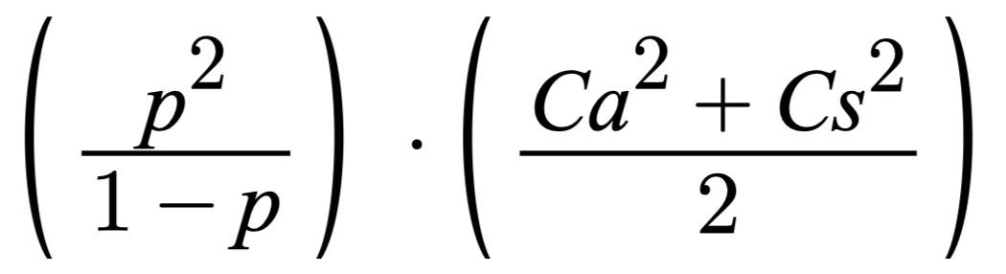
Single Server General Distribution Pk Formula
Iq=
P: Long Run Average Utilization
Ca: Coefficient of Variation of Interarrival Times
Cs: Coefficient of Variation of Service Times
Notes:
To figure out these questions i always write out the variables Iknow- same with littles law. Put all the information in front of you

Slide 34
P: Long Run Average Utilization.
λ /𝞵
Long Run average input rate / long run average processing rate of a server
Ca: Coefficient of Variation of interarrival times
σ{a}/ E {a}
Standard deviation of inter-arrival times / mean of inter-arrival times
Cs: Coefficient of variation of service times
σ{s} / E {s}
Standard deviation of service times / mean of service times
Notes:
So if you see “standard deviations” think general distribution

Slide 35
Exponential/ Poisson Distribution
M/M/1
Exponential Distributed Arrival Times
Exponential Distributed Service Times
1 Server
Notes:
Use this when we dont know what the distribution is, so we have to make some assumptions
-question will say exponential or poission
-question will not include standard deviations, if it includes standard deviation (it might be a trick question!!)

Slide 36
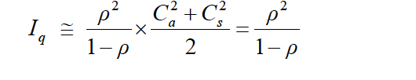
Single Server Poisson Distribution Pk formula
***Cs and Ca each equal 1 in this case
Notes:
The assumptions we make when given an exponential question are making our coefficients of variance equal to 1.

Slide 37
Exponential/ Deterministic Distribution
M/D/1
Exponential Distributed Arrival Times
Determined Service Times- certain service times
1 Server
Notes:
If it gives you the service time, it has been determined and use this formula

Slide 38

Exponential Arrival and Determined Service Time
Ca = 1
Cs = 0 (because there is no variation as it is a determined service time)
Notes:
Explain why its ½

Slide 39
Notes:
Share during 1st break

Slide 40
MULTI-SERVER
Assumptions: In addition to all the single server assumptions.
c = number of servers
The first customer in line will be served by the next available server
P =λ /c𝞵

Slide 41
General Distribution
G/G/c

Slide 42
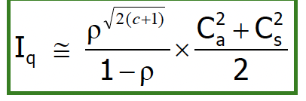
Multi-Server General Distribution Pk Formula
P =λ /c𝞵

Slide 43
Exponential/ Poisson Distribution
M/M/c

Slide 44
Multi-Server Exponential Distribution Pk Formula
P =λ /c𝞵

Slide 45
Exponential / Deterministic Distribution
M/D/c

Slide 46
Multi Server Expo/Determined Distribution Pk Formula
P =λ /c𝞵
1
x
2

Slide 47
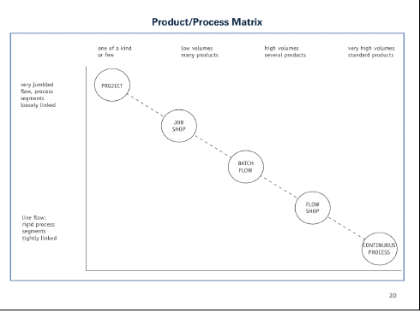
Product/ Process Matrix
FLOW SHOP:
-high volume
-standardized product
-high utilization
Ex: fast food production process
JOB SHOP:
-low volume
-custom orders
-low utilization
Ex: custom shoes / cars

Slide 48
Notes:
Share during 1st break

Slide 49
Demand Forecasting

Slide 50
Demand Forecasting
Demand Forecasting: predicting customers future demand
Methods
Qualitative: delphi method, market research, panel consensus
Quantitative: time series analysis, casual relationship
Notes:
Market research: surveys, interviews
Panel Consensus: qualitative forecasting technique that brings all the internal experts of an organization together for an open discussion about a product or service. Anyone may speak up, and the meeting will end when a consensus is reached. Between customers, executives, sales people
Delphi Method: multiple rounds of questionnaires to selected experts.
Time series analysis: forecasting models trying to predict the future based on past data.
Casual relationship: using explanatory variables to predict the future

Slide 51
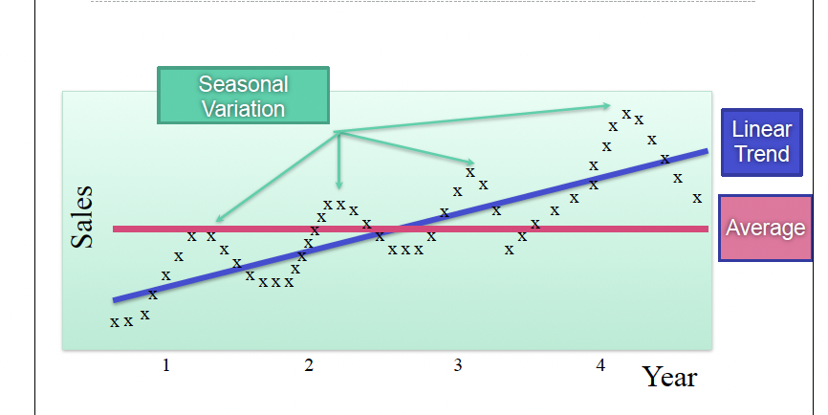
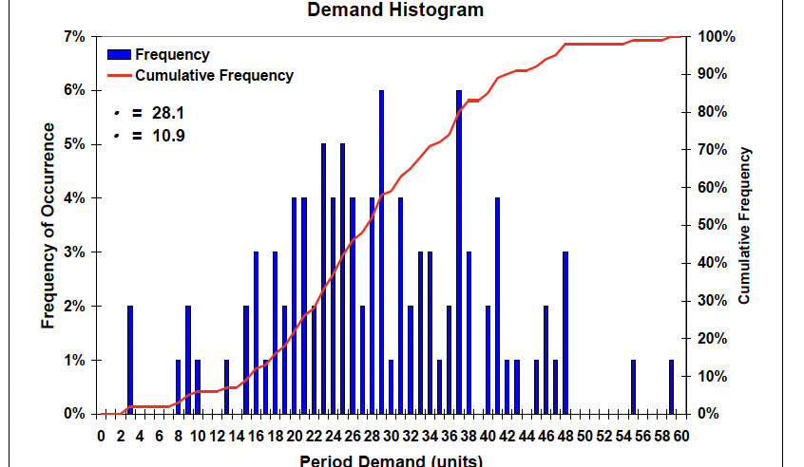
Quantitative Presentation
Notes:
Components of demand: trend, seasonalitiy, average
All seen on the left diagram

Slide 52
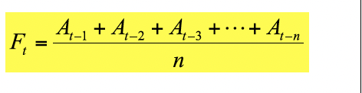
Simple Moving Average
Simple Moving Average: average demand over the last n periods.
Ft- forecast at time (t)
N- number of periods
At- actual data at time (t)
Notes:
First quantitative approach: simple moving average
Based on the idea that future demand is going to be similar to most recent demand.
-commonly 3/6 month or week intervals
-the forecast equals the average of the data over a given amount of periods.

Slide 53
SMA
SMA 3 Week Example
Week (t) | Demand A(t) | 3- Week Moving Forecast F(t)
1 | 567 | N/A
2 | 768 | N/A
3 | 785 | N/A
4 | 578 | =(567+768+785)/ 3
5 | 678 | =(768+785+578) / 3
6 | 600 | =(578+678+600) / 3
Notes:
Not going to use excel to solve because you are not allowed excel on exam

Slide 54
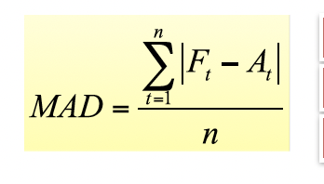
MAD
MAD: Mean Absolute Deviation
The mean of the absolute sum product of the errors
Forecast Error =Forecast- Actual
Notes:
When making forecasts, you also need to evaluate if it is a good forecast, there are different approaches to determining the quality of the forecast, we are going to look at the MAD approach.
-you can see the MAD is lower when the forecast is closer to the actual data
-you must calculate the error (make sure it is absolute- no negatives)
-then find the average of the errors

Slide 55
Practice Problem
What is the MAD for this forecast?
Week | Demand | 3- Week Moving Example
1 | 567 | N/A
2 | 768 | N/A
3 | 785 | N/A
4 | 578 | =(567+768+785)/ 3
5 | 678 | =(768+785+578) / 3
6 | 600 | =(785+578+678) / 3

Slide 56
Practice Problem
What is the MAD for this forecast?
Week | Demand | 3- Week Moving Example | Forecast Error
1 | 567 | N/A | N/A
2 | 768 | N/A | N/A
3 | 785 | N/A | N/A
4 | 578 | 706.66 | 128.66
5 | 678 | 710.33 | 32.33
6 | 600 | 680.33 | 80.33
MAD = (128.66+32.33+80.33) / 3
80.44

Slide 57
Weighted Average
Weighted Moving Average: average demand while placing weight on more recent observations
Ft- forecast at time (t)
N- number of periods
At- actual data at time (t)
W- associated weight
Notes:
-all the weights must add to 1 to have a fully accounted for forecast.
-old data may be relevant, but not as relevant.
-using all the data that the question specifies

Slide 58
Practice Problems
Week (t) | Demand A(t) | Weight for Forecast
1 | 567 | 0.01
2 | 768 | 0.09
3 | 785 | 0.1
4 | 578 | 0.2
5 | 678 | 0.3
6 | 600 | 0.3
What is the forecast for Week 7?

Slide 59
Practice Problems
Week (t) | Demand A(t) | Weight for Forecast
1 | 567 | 0.01
2 | 768 | 0.09
3 | 785 | 0.1
4 | 578 | 0.2
5 | 678 | 0.3
6 | 600 | 0.3
What is the forecast for Week 7?
567(0.01) + 768(0.09) + 785(0.1) + 578(0.2) + 678 (0.3) +600(0.3) = 652.29

Slide 60
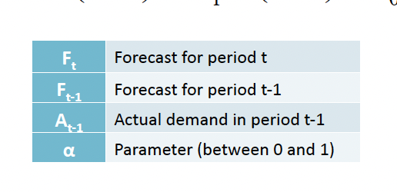

Exponential Smoothing
Exponential Smoothing: smoothing over time series data using exponential weight
Forecast Error: Actual - Forecast
Notes:
For this method, you need a starting point which will be given to you in your question.
I would make sure on your cheat sheet that you have distingusihed that htere is adifference between exponential forecast calculation and werighted average. Exponential is smoother forecast, less in chunks.
-use the forecast from the previous week to continue forecasting for the upcoming weeks

Slide 61
Practice Problem
What are the forecasted levels for week 4,5,6?
Sigma level = 0.7 (week 3 spending was forecasted to be 650)
Week | Demand | Forecast
1 | 567
2 | 768
3 | 785 | 650 (given in question)
4 | 578
5 | 678
6 | 600

Slide 62
Practice Problem
What are the forecasted levels for week 4,5,6?
Sigma level = 0.7 (week 3 spending was forecasted to be 650)
Week | Demand | Forecast
1 | 567
2 | 768
3 | 785 | 650 (given in question)
4 | 578 | 650 + 0.7(785-650) = 744.5
5 | 678 | 627.95
6 | 600 | 662.99

Slide 63
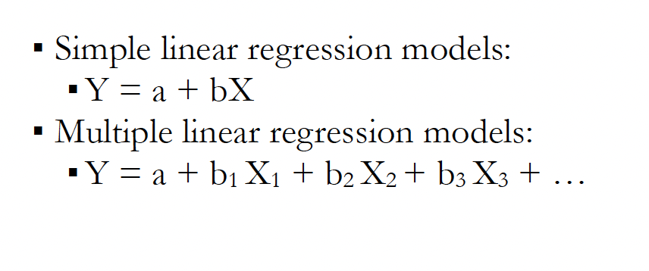
Casual Relationship
Casual Relationship: using explanatory variables to forecast
Notes:
Seen this in stats, calculus, comm 295
-quantitiative method but not time series because it is not taking past data to forecast for the future.

Slide 64
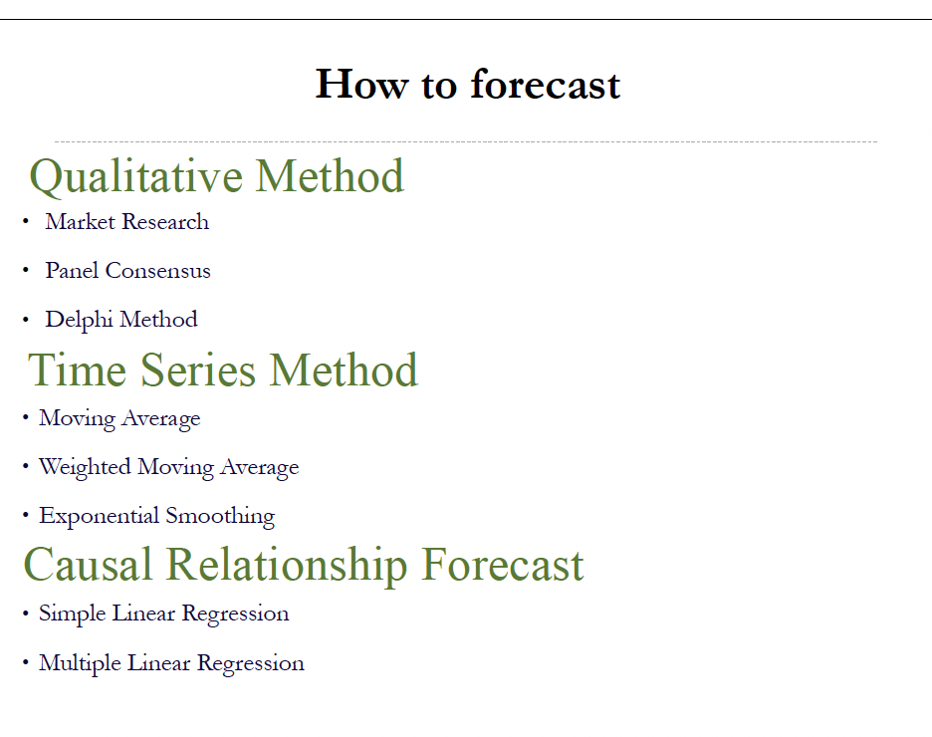
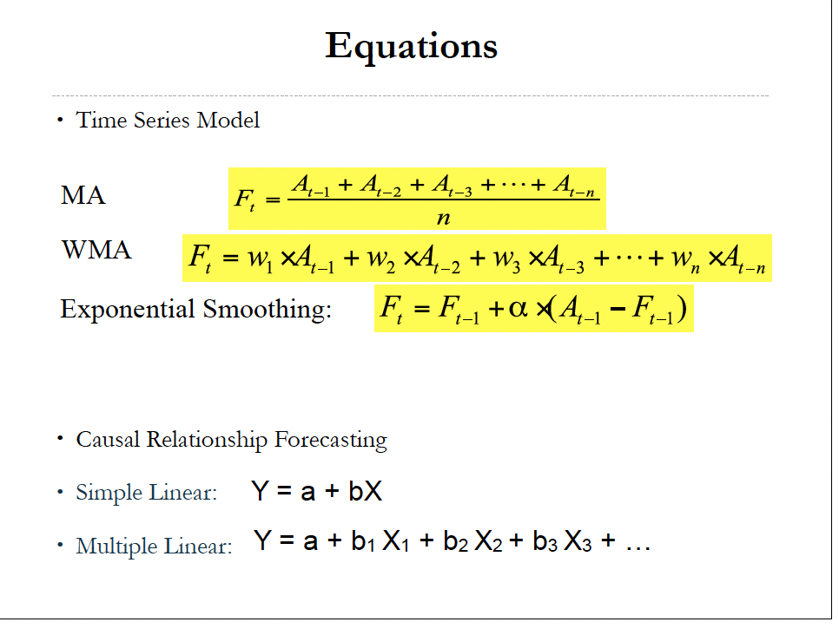
Demand Forecast Summary

Slide 65
Project Management

Slide 66
Project Management
Project: A set of related tasks or activities, directed towards some major output and requiring a significant period of time to perform
Ex: construction of a bridge, concerts at Rogers Arena, product launches.
Notes:
Most extreme version of job shop

Slide 67
Critical Path
Critical Path diagram: identifies all possible paths between first and last task.
Critical Path: maximum path time
-time it takes to finish the project (determines project duration)
All activities on critical path, are critical activities
Notes:
Set of related activities create paths

Slide 68
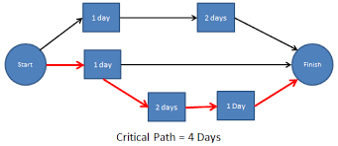
Critical Path Diagram

Slide 69
Cost Information
Crashing: activity of shortening critical path
Crash Time: minimum possible time to complete an activity. Not the amount of time cutting off.
Crash Cost: cost associated with the crash time. Not the final cost.
*shortening activities that are not critical will not affect project duration

Slide 70
Crash Cost
Crash Cost Per Day:
Crash Cost - Cost / Time - Crash Time

Slide 71
Project Management Goals
Shortening Timeframe
Minimizing Costs
Helpful Steps to determine solutions for these goals:
-determine network diagram & critical path
-determine crash cost per day for each crashable activity
-create a scorecard to keep track of crashing

Slide 72
Critical Path
The owner wants you to you to finish the project in 110 days. Find the minimum possible cost for the project if you want to finish it on 110 days.
Activity | Precedence | Time (days) | Crash Time (days) | Cost | Crash Cost
A | N/A | 120 | 100 | 12000 | 14000
B | N/A | 20 | 15 | 1800 | 2800
C | B | 40 | 30 | 16000 | 22000
D | C | 30 | 20 | 1400 | 2000
E | D&F | 50 | 40 | 3600 | 4800
F | B | 60 | 45 | 13500 | 18000

Slide 73
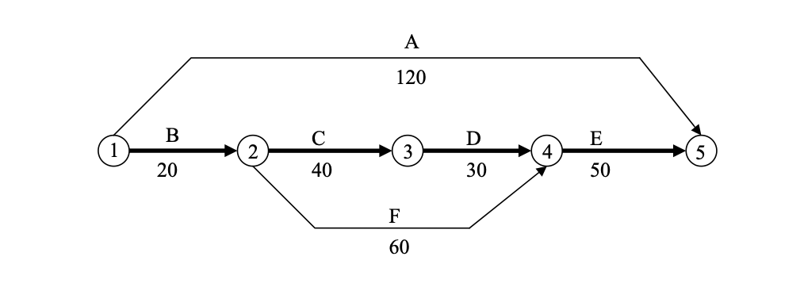
Paths:
A: 120 days
B,C,D,E: 140 days
B,F,E: 130 days

Slide 74
Crash Cost Per Day
A: (14000-12000)/ (120-100) = 100/DAY
B: 200/ day
C: 600/ day
D 60/ day
E: 120/ day
F: 300/ day

Slide 75
Crashing Scorecard
Crashing Scorecard
Total Project Cost | # Days | Critical Paths | Crashable tasks | Best Option
48300 | 140 | B,C,D,E | B,C,D,E | D- 10
48900 | 130 | (B,C,D,E) + (B,F,E) | B, C, E, F | E- 10
50100 | 120 | A + B-C-D-E + B-F-E | A, B, C, F | A- 5 B- 5
51600 | 115 | A, B-C-D-E, B-F-E | A, C, F | A- 5 C-5 F- 5
56600 | 110

Slide 76
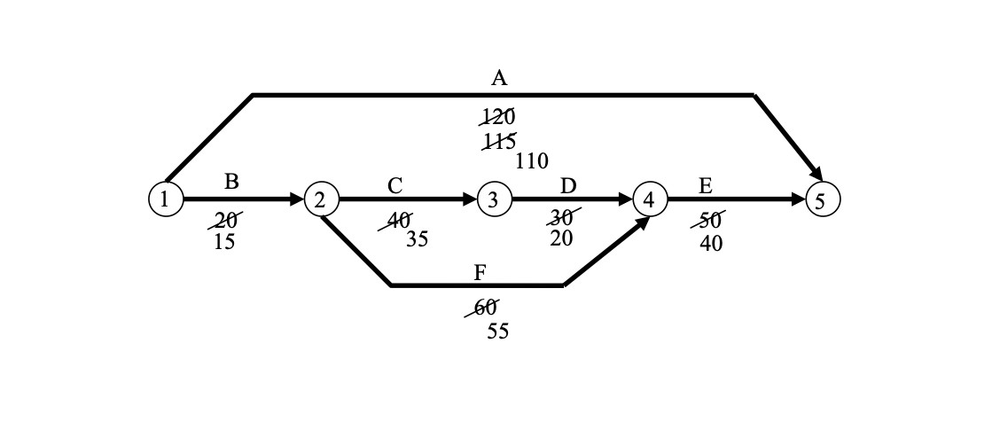

Slide 77
BCWS: budgeted cost of work scheduled to date
BCWC: budgeted cost of work completed to date
ACWC: actual cost of work completed to date

Slide 78
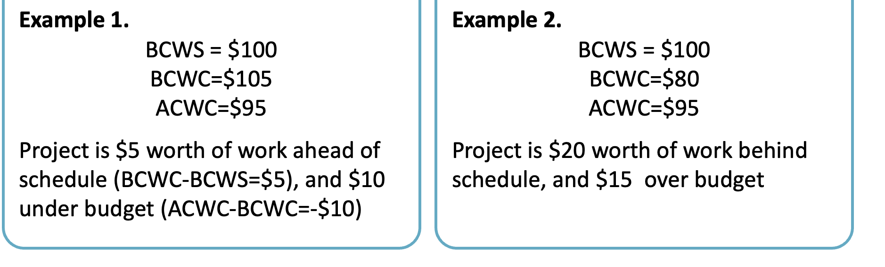
Elements of Time and Cost Analysis
Work Ahead of Schedule: BCWC>BCWS
Work Behind Schedule: BCWC<BCWS
Over Budget: ACWC>BCWC
Under Budget: ACWC<BCWC

Slide 79
Inventory Management
Notes:
-bullwhip effect

Slide 80
Inventory
Types of Inventory
Seasonal Inventory
Safety stock
Cycle Stock: working inventory
Pipeline Inventory: inventory on route
Notes:
Cycle stock- inventory to meet customer demand
Safety stock: inventory held just in case- uncertain demand

Slide 81
Inventory Analysis
Inventory Analysis
Inventory Turnover: Cost of goods sold/ average inventory
Days in Inventory : 365/ Inventory Turnover

Slide 82
Inventory: Newsvendor

Slide 83
Newsvendor Model
Newsvendor Model
Uncertain Demand
Perishable Product
One-Time Decision
Examples: Newspaper, Merchandise at a sporting event
Decision: stocking quantity that minimizes costs
Notes:
Perishable and one time decision for stocking quantity is the difference between this and EOQ

Slide 84
Newsvendor Model
Newsvendor Costs
Overage Cost Co: cost of overstocking the product (wasted inventory)
Underage Cost Cu: Cost of understocking the product (lost potential profits)
Optimal Stock Level: Newsvendor Ratio: Cu / (Cu+Co)
(minimizing costs)
Notes:
Optimal stock level is the probability that demand is less than or equal to the quantity stocked. Finding a quantity that the probability is meeting all the demand. Probability of not stocking out.

Slide 85
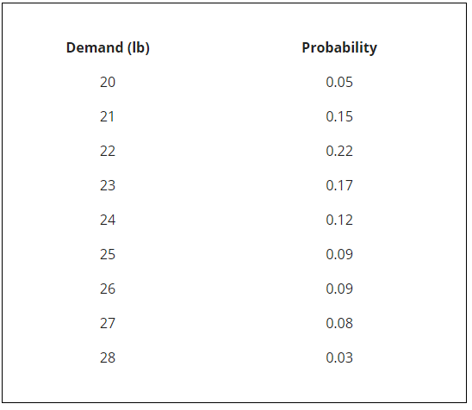
Discrete Demand
Discrete Demand:
Seen in goods that can only be sold as whole units.
Optimal stocking level:
Smallest level Q that surpases given desired service level.
Safety Stock = Q- E(D)
Notes:
Expected demand is sumprodut of all demand * their probabilities

Slide 86
What is the optimal stocking quantity given a 90% desired service level?

Slide 87
What is the optimal stocking quantity given a 90% desired service level?
27, this would get you to 97%
Notes:
Will get you to 97% but is still the smallest that is closely to 90%

Slide 88
Newsvendor Normal Distribution (continuous)
Q = 𝜇 + z * 𝝈
Z = Q-𝜇 / 𝝈
Q: order quantity
Notes:
The formula depends on the information you are given.

Slide 89
Newsvendor Problem
Demand for Canucks jerseys is normally distributed with mean 2000 jerseys and standard deviation 400. (hint: use excel for z-score)
Cost of Jersey: 15$
Selling price: 25$
Unsold Jerseys can be sold off for 10$
What is the optimal stocking level?

Slide 90
Overage Cost: 5
Underage Cost: 10
Newsvendor Ratio: 10/15 = 0.666
Z = Normsinv (0.666)
Q = 2000 + 400* 0.43 = 2172
Notes:
First find the overage and underage costs, plug them into the newsvendor formula, then take all your data and plug it into equation that solves for Q.

Slide 91
Risk Pooling
Centralization/ Risk Pooling: creating pooled demand streams to decrease variability in processes.
Method in pooling:
-physical centralization: warehouse
-information centralization: singular data bases
-commonality: creating similar utility of a product
-postponement/ late customization: delaying differentiation
Examples: warehouse, hard drives for common usage
Notes:
Discussed in variaiblity in processes.
Exam question: may be asked to figure out the safety stock for the process before and after using a risk pooling method

Slide 92

Notes:
Share during 2nd break

Slide 93
Inventory: EOQ
Notes:
Economic order quantity model finds a level Q
-minimizes costs
-trigger by certain level of stock

Slide 94
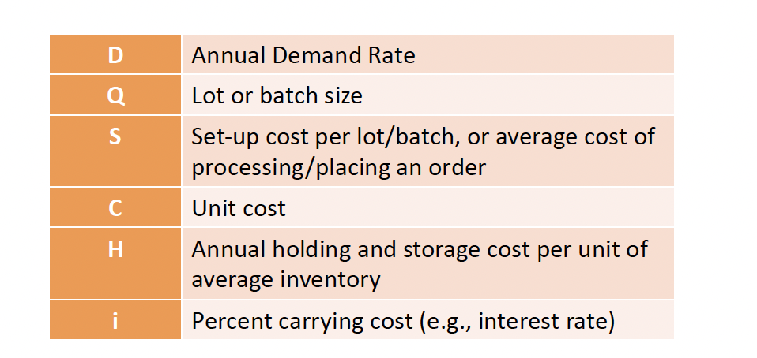
Notation
Usually H = i*C
Notes:
D- annual specifically, there may be questions where you are given weekly/ daily demand, and you will need to multiple by 52 or 365 to achieve the true value of D. i say 52 and 365 as default, but the question may include the assumption to go by. Ex: 50 weeks in a week, or 360 days in a year.

Slide 95
Number of Orders Per Year: D/Q
Order Frequency: 365/ Number of Orders per Year
Cycle Time (time in between orders): Q/D

Slide 96
Annual Set-Up Cost = (D/Q)*S (number of orders per year * set up cost per order)
Annual Holding Cost = (Q/2) * H (cycle stock * annual holding cost)

Slide 97
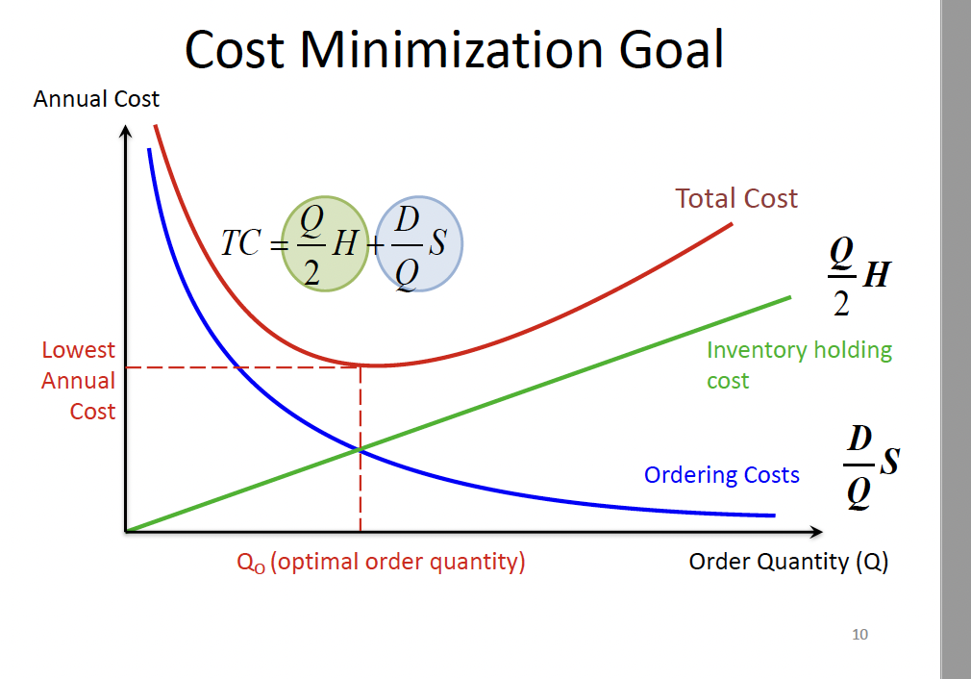
Cost Minimizing
Costs are minimized where Annual Set up Cost = Annual Holding Cost
Notes:
Where fixed costs = variable costs, when the derivative of the total cost curve = 0

Slide 98
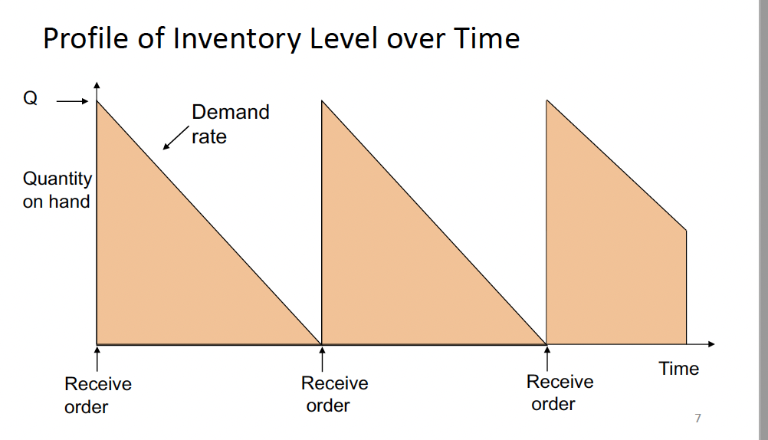

Slide 99
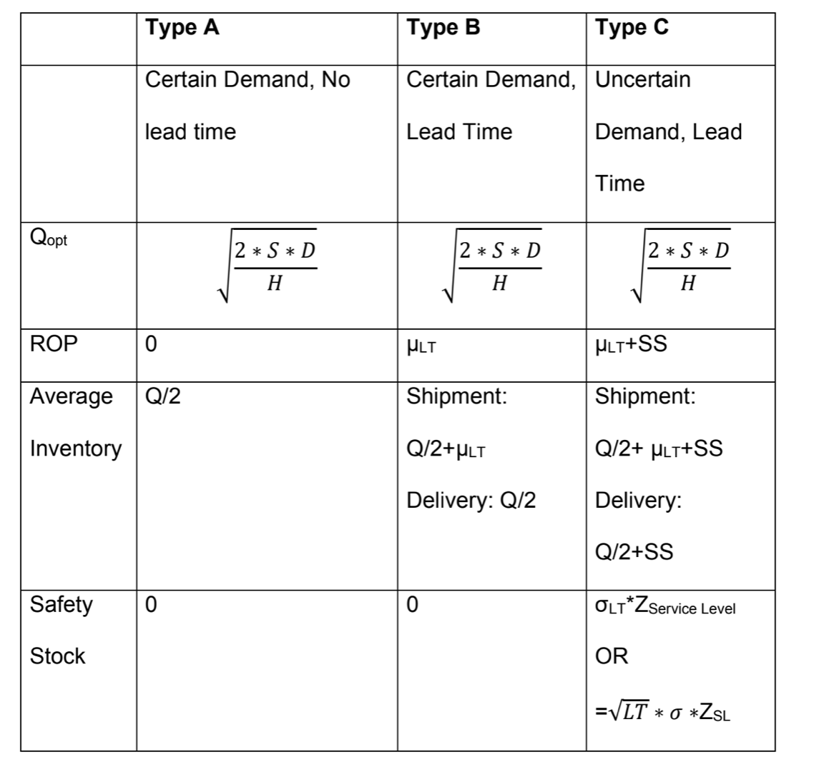
Notes:
Recommend putting something like this on the cheat sheet
-variables from the notation in the last slide
Re-order point: particular level of quantity that triggers a re order

Slide 100
Type A
Type A: Certain Demand & No Lead Time
Notes:
-there is no reorder point because there is no lead time , average inventory is only the cycle inventory because it is what yo
-level of stock that triggers reorder is 0.
-there does not need to be safety stock either because we know what the demand will be, so there is no need to incur more inventory cost when we know how much we need

Slide 101
Practice Problem
Amazon estimates its carrying cost at 15% and its ordering cost at $9 per order. The estimated annual demand rate is 48,000 units at a price of $4 per unit.
What is the most economical no. of units to order?
How many orders should be placed in a year?
How often should orders be placed?
What is the annual ordering cost?
What is the annual carrying cost?
What is the combined ordering and holding cost at the EOQ? (including purchasing cost)

Slide 102
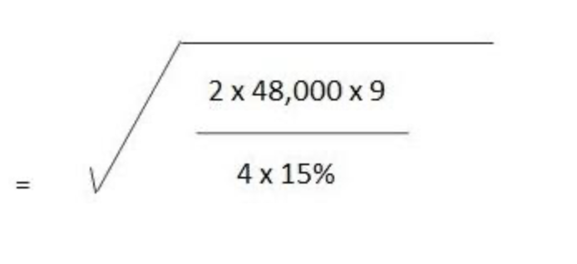
Answer
EOQ: 1200
40 Orders: 48000/1200
365/40 = 9.125
40*9 = 360
1200/2 * 0.6 = 360
360+360+ ( 4*1200*40) = 192,700

Slide 103
Type B: Certain Demand & Lead Time
Notes:
Lead time is the time between placing and receiving an order. There are still customers demanding product during this time so it is important to have stock while more is coming.

Slide 104
Type B
Reorder Point: Annual Demand Rate * Lead Time. Lead time demand
What is the reorder point for a company that has a weekly demand rate of 60, and a lead time of 2 weeks?
Notes:
Days * demand per day- intuition
-make sure time units are the same

Slide 105
Type B
What is the reorder point for a company that has a weekly demand rate of 60, and a lead time of 2 weeks?
60*2 = 120
3120 * 2/52 = 120
Notes:
Days * demand per day- intuition
-make sure time units are the same

Slide 106
Pipeline Inventory: on route inventory
Pipeline Inventory = Demand during lead time D*LT
Default is no pipeline inventory, will be indicated in question to include.
used when the buyer pays for the inventory when it is shipped from the seller. (FOB Shipping Point)
Effect on Average Inventory: Q/2 + D*LT

Slide 107
Type C
Type C: Uncertain Demand & Lead Time
Notes:
Average inventory just includes the safety stock introduced with this situation.

Slide 108
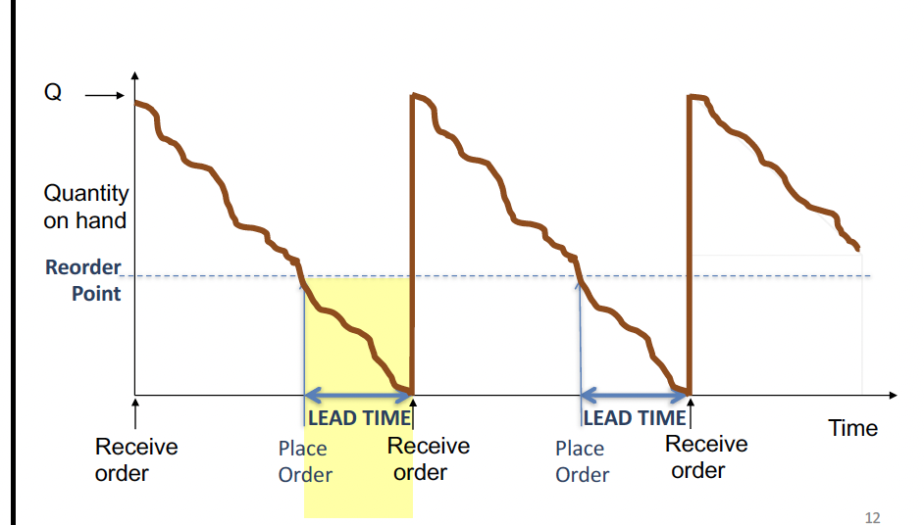
Type C
Lead Time and Uncertain Demand: normally distributed demand
CSL: probability of not stocking out
Notes:
We are not exactly sure the demand or the demand during lead time, this introduces a new concept of safety stock that gives companies a safety net. Three things can happen with uncertain demand
ROP = DLT
Rop > DLT : surplus
ROP <DLT : shortage
CSL- similar to newsvendor with the uncdertain demand, - measures reliability of the system

Slide 109
Type C - Given CSL
Solving for Reorder Point: DLT + SS
DLT normal distribution: mean demand during lead time
Safety Stock normal distribution: standard deviation during lead time * z score given CSL
ROP = mLT + z* 𝝈LT
Notes:
ROP is pretty much the same as type B, but with an extra level of stock that accounts for the probability of stocking out. Demand is now normally distributed though, so we have some additional calculations to find this level D
K- lead time
M- mean of demand

Slide 110
ROP = mLT + z* 𝝈LT
K - lead time ( given in question)
M- mean (given in question)
MLT = k*m
z= normsinv (CSL)
𝝈LT = sqrt(k) * standard deviation
Safety Stock: ROP - DLT (second part of the equation)
Notes:
Breaking down this formula
Safety safy - z * standard deviation of lead time

Slide 111
Type C
Solving for Z-Score: (Given the ROP in question)
Z = ROP - MLT / 𝝈LT
Notes:
This may be relevant for a cheat sheet so i thought id include it

Slide 112
PRactice Problem
Demand is normally distributed with standard deviation 10, and average weekly demand of 120. Cost of good is 150$, set up costs are 90, handling costs are 20% of the purchase price. Lead time is 1-week, assuming 52 weeks/year. Given a z score: 1.64
What is the necessary safety stock for this desired level? What should the reorder point be?

Slide 113
Answer
ROP = mLT + z* 𝝈LT
MLt = (120*52) * (1/52) = 120
Standard deviation: 1 * 10 = 10
1.64*10 = 16.4
Reorder Point: 16.4+120 = 136.4
Safety Stock: 16.4

Slide 114
Fixed-Time Period Model

Slide 115
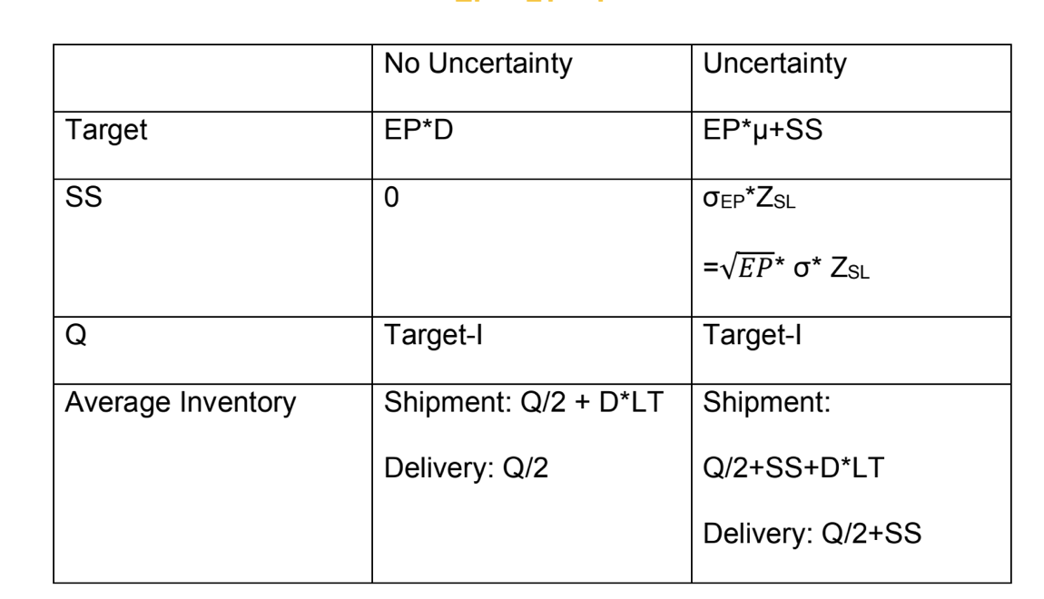
Periodic Review System

Slide 116
Periodic Review Systems: inventory is counted and reorder is placed in predetermined intervals, such as a week or a month
Assuming No demand uncertainty
Target inventory = (LT+T)*D
Order Quantity = (LT+T) *D-I
LT: Lead Time: time between placing and receiving order
T: Review Period ( time between placing orders)
LT+T: exposure period=
I: current Inventory level
Notes:
placing orders on a periodic basis is desirable in situations where vendors make routine visits to customers and take orders for their complete line of products, or when buyers want to combine orders to save transportation cost

Slide 117
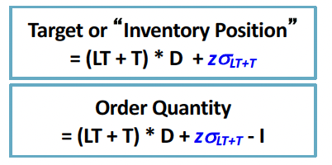
Demand Uncertainity
Demand Uncertainty
z𝝈LT+T
Z = normsinv (CSL)
𝝈LT+T = sqrt (LT+T)*𝝈

Slide 118
Practice Problem
Average Daily Demand: 10 units
Standard Demand for Daily Demand: 2 units
Review Period 30 days
Lead Time: 10 days
Policy: not stocking out 95% of the time
Beginning inventory: 150 Units
How many units should be ordered?

Slide 119
Answer
Exposure Period: 40 Days
Z-score: normsinv(0.95) = 1.64
𝝈LT+T = 6.32*2 = 12.64
Target: 40*10 + 1.64*12.64
=420.73
Order Quantity:
420.73 - 150 = 270.73
Notes:
6.32- square root of 40

Slide 120
Sarah’s 204 Study Tips
Know the difference between all the different Pk Formulas, and inventory management problems.
Practice problems on practice problems!!!
Go over previous assignments, cases, CMP packages
Notes:
Get a good taste of what your professors may try to trick you on

Slide 121
Thank you!
Feel free to stick around to ask some questions

Slide 122
Notes:
Share during 2nd break

